Slide 1

Programowanie w Pythonie Wstęp do sieci neuronowych
Łukasz Mioduszewski, UKSW 2022

Slide 2
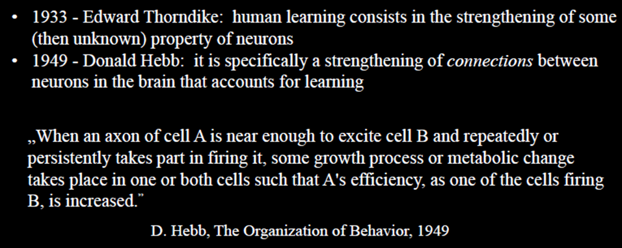
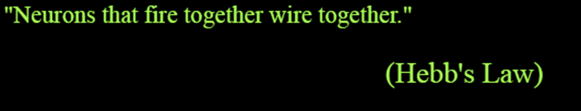
Sieci Neuronowe - historia

Slide 3
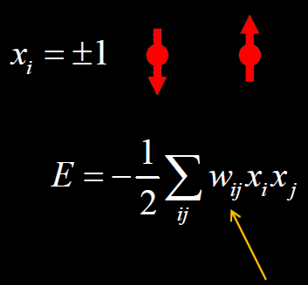


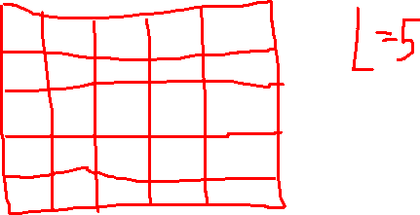

Sieć Hopfielda
Pomysł Hopfielda (1982): jeden „neuron” odpowiada jednemu pikselowi obrazu (czarno-białego, a więc ma wartość +1 albo -1)
Każdy neuron może być „połączony” z każdym przy użyciu macierzy wagi w
Dążymy do minimalizacji energii

Slide 4
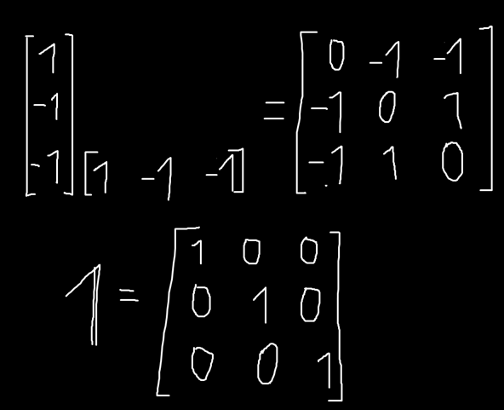
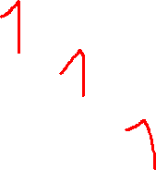
Uzupełnienie matematyczne
Iloczyn zewnętrzny
Macierz jednostkowa

Slide 5

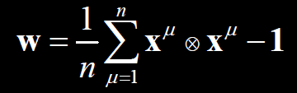
Sieć Hopfielda
„uczymy” sieć nowych wzorów, może ich być n:
Takie same wartości dadzą dodatnie w, czyli ujemną energię
To są macierze!

Slide 6
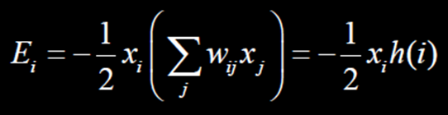


Sieć Hopfielda
energia i-tego spinu:
Ewolucja w czasie:

Slide 7
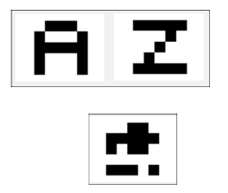
Sieć Hopfielda w praktyce
Zadanie: prosty OCR (Optical Character Recognition)
Wprowadzamy dwa wzory do nauczenia się: litery A i Z
Reprezentujemy je jako obrazki 5x5 pikseli
Zaczynamy z czegoś zdeformowanego
A = """
OXXXO
XOOOX
XXXXX
XOOOX
XOOOX
"""
Z = """
XXXXX
OOOXO
OOXOO
OXOOO
XXXXX
"""

Slide 8
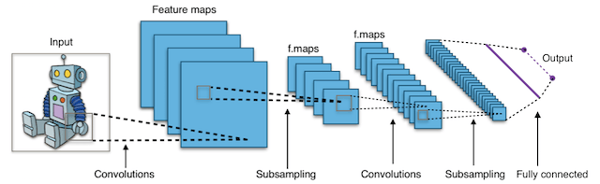
Sieci neuronowe dziś
Każdy neuron pobiera dane (liczby), każdą daną mnoży przez wagę, czego wynikiem jest liczba, która staje się daną dla kolejnej warstwy neuronów
Deep learning – na tyle wiele warstw że nie wiemy co się dzieje

Slide 9
Biblioteka Keras
Wysokopoziomowy "frontend" do TensorFlow od Google
Alternatywa: FastAI ("frontend" do PyTorch od Facebook/Meta)
Oba są open source

Slide 10
Biblioteka Keras
Wymagania:
Python 3+
SciPy z NumPy
Matplotlib (tylko do rysowania, niekonieczny)
Instalacja przez pip: pip install tensorflow # zwykle wystarczy pip install keras # jeśli nie, to jeszcze to
Instalacja przez Anacondę: https://elitedatascience.com/keras-tutorial-deep-learning-in-python

Slide 11
Początek skryptu
keras_CNN_example.py
1 2 3 4 5 6 7 8 9 10 | import numpy as np np.random.seed(123) # for reproducibility from keras.models import Sequential # sequential neural network from keras.layers import Dense, Dropout, Activation, Flatten # usual layers from keras.layers import Convolution2D, MaxPooling2D # to train on image data from keras.utils import np_utils # some utilities

Slide 12
Ładowanie bazy danych do uczenia sieci
keras_CNN_example.py
1 2 3 4 5 6 7 8 9 10 | import numpy as np np.random.seed(123) # for reproducibility from keras.models import Sequential # sequential neural network from keras.layers import Dense, Dropout, Activation, Flatten # usual layers from keras.layers import Convolution2D, MaxPooling2D # to train on image data from keras.utils import np_utils # some utilities from keras.datasets import mnist # Load pre-shuffled MNIST data into train and test sets (X_train, y_train), (X_test, y_test) = mnist.load_data()

Slide 13
Ładowanie bazy danych do uczenia sieci
keras_CNN_example.py
1 2 3 4 5 6 7 8 9 10 11 11 | import numpy as np np.random.seed(123) # for reproducibility from keras.models import Sequential # sequential neural network from keras.layers import Dense, Dropout, Activation, Flatten # usual layers from keras.layers import Convolution2D, MaxPooling2D # to train on image data from keras.utils import np_utils # some utilities from keras.datasets import mnist # Load pre-shuffled MNIST data into train and test sets (X_train, y_train), (X_test, y_test) = mnist.load_data() print( X_train.shape ) # 60k samples, each is a 28x28 black-and-white image # (60000, 28, 28) # X_train to dane do treningu, y_train to poprawne wyniki dla tych danych # X_test to dane testujące sieć, y_test to pożądany wynik

Slide 14
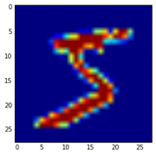
Ładowanie bazy danych do uczenia sieci
keras_CNN_example.py
1 2 3 4 5 6 7 8 9 10 11 11 12 13 | import numpy as np np.random.seed(123) # for reproducibility from keras.models import Sequential # sequential neural network from keras.layers import Dense, Dropout, Activation, Flatten # usual layers from keras.layers import Convolution2D, MaxPooling2D # to train on image data from keras.utils import np_utils # some utilities from keras.datasets import mnist # Load pre-shuffled MNIST data into train and test sets (X_train, y_train), (X_test, y_test) = mnist.load_data() print( X_train.shape ) # 60k samples, each is a 28x28 black-and-white image # (60000, 28, 28) from matplotlib import pyplot as plt plt.imshow(X_train[0])

Slide 15
Preprocessing inputu
keras_CNN_example.py
14 15 16 17 18 19 20 21 22 23 24 25 26 27 28 29 30 | # tensorflow must know how many channes there are, so the last dimension should be the number of channels (in this case, one) X_train = X_train.reshape(X_train.shape[0], 28, 28, 1) X_test = X_test.reshape(X_test.shape[0], 28, 28, 1) print( X_train.shape ) # (60000, 28, 28, 1) X_train = X_train.astype('float32') # input data must be float32 X_test = X_test.astype('float32') X_train /= 255 # input data must be in range from 0 to 1 X_test /= 255

Slide 16
Preprocessing outputu
keras_CNN_example.py
14 15 16 17 18 19 20 21 22 23 24 25 26 27 28 29 30 | # tensorflow must know how many channes there are, so the last dimension should be the number of channels (in this case, one) X_train = X_train.reshape(X_train.shape[0], 28, 28, 1) X_test = X_test.reshape(X_test.shape[0], 28, 28, 1) print( X_train.shape ) # (60000, 28, 28, 1) X_train = X_train.astype('float32') # input data must be float32 X_test = X_test.astype('float32') X_train /= 255 # input data must be in range from 0 to 1 X_test /= 255 print( y_train[:10] ) # [5 0 4 1 9 2 1 3 1 4] # y_train tells which digit is showed in every picture # Convert 1-dimensional class arrays to 10-dimensional class matrices Y_train = np_utils.to_categorical(y_train, 10) Y_test = np_utils.to_categorical(y_test, 10) print( Y_train.shape ) # (60000, 10)

Slide 17

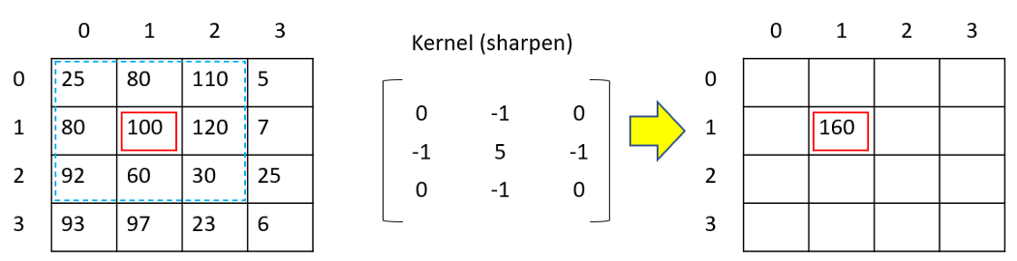
Konwolucja
Konwolucja pomiędzy obrazkiem a filtrem/jądrem konwolucji (convolution kernel/filter, tak jak te okna Hanninga albo Blackmana)
g to wyjściowy obraz, f to wejściowy obraz, w to filtr

Slide 18
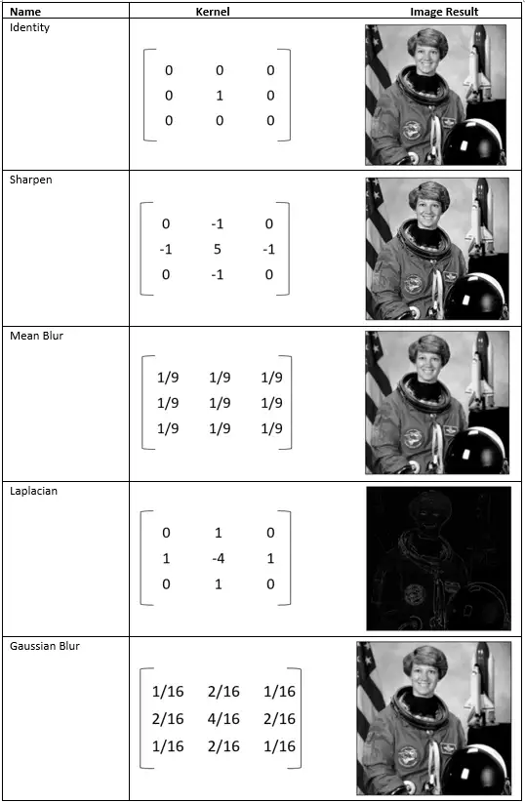
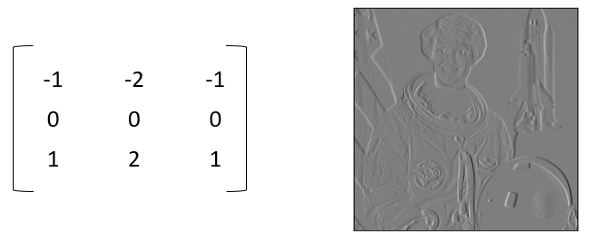
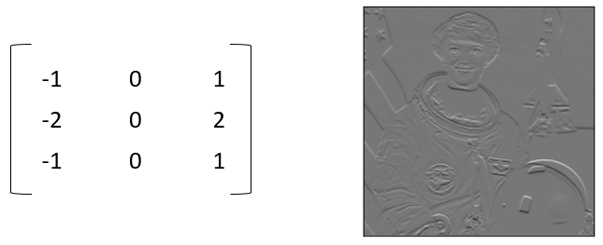
Konwolucja

Slide 19
Architektura sieci
keras_CNN_example.py
32 33 34 35 36 37 38 39 40 41 42 43 44 45 46 47 48 | model = Sequential() # defining input layer. input_shape should be the shape of 1 sample. # here it’s (28, 28, 1) = (width, height, channels) of each digit image. model.add(Convolution2D(32, (3,3), activation='relu', input_shape=(28,28,1))) # 32 convolution filters, each of them is a 3x3 matrix print( model.output_shape ) # (None, 26, 26, 32) corresponds to (samples, new_rows, new_cols, filters) # model will output all samples, convoluted into 26x26 array using 32 filters # adding more layers model.add(Convolution2D(32,(3,3),activation='relu')) # regularization max(x,0) model.add(MaxPooling2D(pool_size=(2,2))) # way to reduce number of parameters in our model by sliding a 2×2 pooling filter across the previous layer and taking the max of the 4 values in the 2×2 filter model.add(Dropout(0.25)) # killing some neurons

Slide 20
Architektura sieci – idziemy głębiej
keras_CNN_example.py
50 51 52 53 54 55 56 57 58 59 60 61 62 63 64 65 | model.add(Flatten()) # flattens the input (1 channel) model.add(Dense(128, activation='relu')) # 128 is the output size # keras automatically matches layer input/output sizes model.add(Dropout(0.5)) # killing excessive neurons again model.add(Dense(10, activation='softmax')) # normalize the output # to a probability distribution over predicted output classes

Slide 21
Kompilacja modelu
keras_CNN_example.py
50 51 52 53 54 55 56 57 58 59 60 61 62 63 64 65 | model.add(Flatten()) # flattens the input (1 channel) model.add(Dense(128, activation='relu')) # 128 is the output size # keras automatically matches layer input/output sizes model.add(Dropout(0.5)) # killing excessive neurons again model.add(Dense(10, activation='softmax')) # normalize the output # to a probability distribution over predicted output classes model.compile(loss='categorical_crossentropy', optimizer='adam', metrics=['accuracy']) # loss function defines the "cost" associated with good/bad image recognition

Slide 22
Trenujemy nasz model
keras_CNN_example.py
50 51 52 53 54 55 56 57 58 59 60 61 62 63 64 65 | model.add(Flatten()) # flattens the input (1 channel) model.add(Dense(128, activation='relu')) # 128 is the output size # keras automatically matches layer input/output sizes model.add(Dropout(0.5)) # killing excessive neurons again model.add(Dense(10, activation='softmax')) # normalize the output # to a probability distribution over predicted output classes model.compile(loss='categorical_crossentropy', optimizer='adam', metrics=['accuracy']) # loss function defines the "cost" associated with good/bad image recognition model.fit(X_train, Y_train, batch_size=32, epochs=10, verbose=1) # Epoch 1/10 # 7744/60000 [==>.................] - ETA: 96s - loss: 0.5806 - acc: 0.816

Slide 23
Testujemy nasz model
keras_CNN_example.py
50 51 52 53 54 55 56 57 58 59 60 61 62 63 64 65 | model.add(Flatten()) # flattens the input (1 channel) model.add(Dense(128, activation='relu')) # 128 is the output size # keras automatically matches layer input/output sizes model.add(Dropout(0.5)) # killing excessive neurons again model.add(Dense(10, activation='softmax')) # normalize the output # to a probability distribution over predicted output classes model.compile(loss='categorical_crossentropy', optimizer='adam', metrics=['accuracy']) # loss function defines the "cost" associated with good/bad image recognition model.fit(X_train, Y_train, batch_size=32, epochs=10, verbose=1) # Epoch 10/10 score = model.evaluate(X_test, Y_test, verbose=0)

Slide 24
A jak potem tego używać?
y_krm = model.predict(x)
Można też używać metody call(), ale są pewne subtelne różnice: https://stackoverflow.com/questions/60837962/confusion-about-keras-model-call-vs-call-vs-predict-methods?fbclid=IwAR0wAIRHfSa2o6-qriOgLp64lfXhNtLr8kk8f9jF9Q67_hdgJVvjzM5MBW8
Aby zapisać model: model = ... # Get model (Sequential, Functional Model, or Model subclass) model.save('path/to/location')
Aby odczytać model: from tensorflow import keras model = keras.models.load_model('path/to/location')

Slide 25
Bibliografia
https://elitedatascience.com/keras-tutorial-deep-learning-in-python
https://www.knowledgehut.com/blog/data-science/pytorch-vs-tensorflow
https://medium.com/@ianormy/convolution-filters-4971820e851f
https://www.activestate.com/resources/quick-reads/what-is-a-keras-model/

